Slide 1
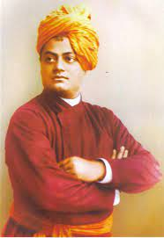
SWAMI VIVEKANANDA INSPIRING THE YOUTH!
Presented by: Shreerang Mhatre
Roll. No: 29
Batch: A2
Submitted to: Prof. Rekha Joshi Ma’am
Topic : PSRS Biography PPT

Slide 2
Introduction and Early Life
Spiritual Leader and Social Reformer
Influential Personality inspiring the youths of India
Great orator, Great Thinker and Passionate Patriot
Born : 12 January, 1863
Childhood name: Narendranath Dutta
Parents: Vishwanath Dutta and Bhuvaneshwari Devi
Death: 4 July, 1902

Slide 3
Educational Highlights
Education: Calcutta Metropolitan School
Presidency College, Calcutta
“Arise, awake and stop not until the goal is achieved”- Swami Vivekananda
Avid reader, persued the Hindu scriptures like Bhagwad Gita and the Upanishads
Studied western philosopy, history and spirituality by David Hume, Johann Gottlieb Fichte and Herbert Spencer

Slide 4
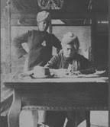
Work for the Society
Religious views focused on Hinduism
Publications : Karma Yoga (1896); Raja Yoga (1896); Lectures from Colombo to Almora (1897); My Master (1901)
Letters of Swami Vivekananda
Swami Vivekananda’s Speeches at the Parliament of Religions, Chicago, 1893
Jnana Yoga: The Yoga of Knowledge

Slide 5
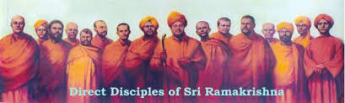
Contributions
Yoga : The Yoga of Love and Devotion
Yoga: The Yoga of Action
Raja Yoga: The Yoga of Meditation
Contribution to Social Reform: FOUNDER OF RAMAKRISHNA MISSION
Spiritual Teachings of Divine manifestations
Philosophy : Advaita Vedanta
Founder of : Ramakrishna Math, Vedanta Society of New York

Slide 6
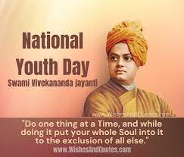
Awards & Recognition
Representative of Neo- Vedanta
A true patriot imbibing national
awakening among the youth during
the Independence era.
Known for his spiritual awakening
Recognitions in honor of:
Swami Vivekananda Values Education Project (2010)
Swami Vivekananda Technical University, Chattisgarh
Swami Vivekananda Airport, Raipur
National Youth Day- 12 January
World Brotherhood Day- 11 September 1893

Slide 7
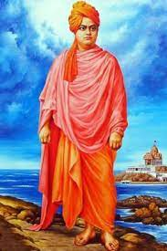
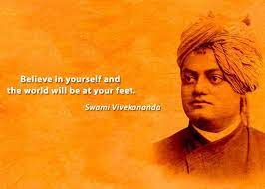
Legacies to the World
Universalism
Devoted Hindu, not communal
Social reformer and spiritual leader
Awakened Youth of India and the virtue of Patrotism among them
Promoted social harmony
Teaching Hinduism and its virtues to the world

Slide 8
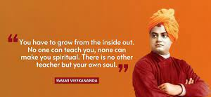
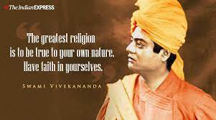
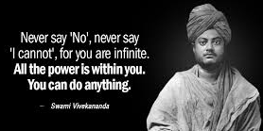
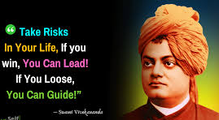
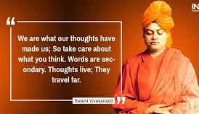
Social Teachings

Slide 9
References
https://www.britannica.com/biography/Vivekananda
https://ramakrishna.org/vivekananda.html
https://vedantasociety.net/vivekananda
https://www.hindustantimes.com/india-news/shall-forever-remain-indebted-to-him-india-pays-tribute-to-swami-vivekananda-101625371881995.html
https://www.jagranjosh.com/general-knowledge/swami-vivekananda-1547214232-1
Image courtesy: www.google.com

Slide 10
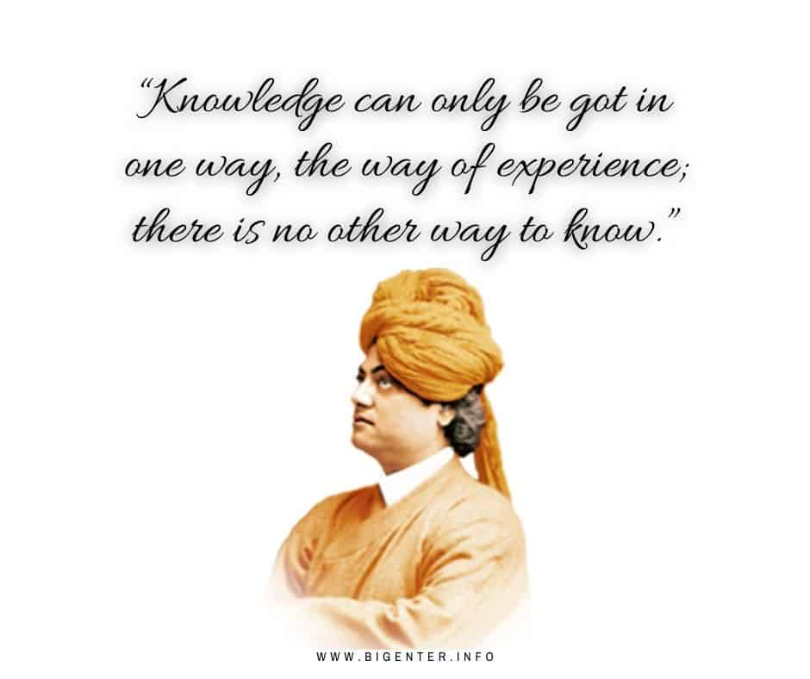
THANKYOU!

